Slide 1
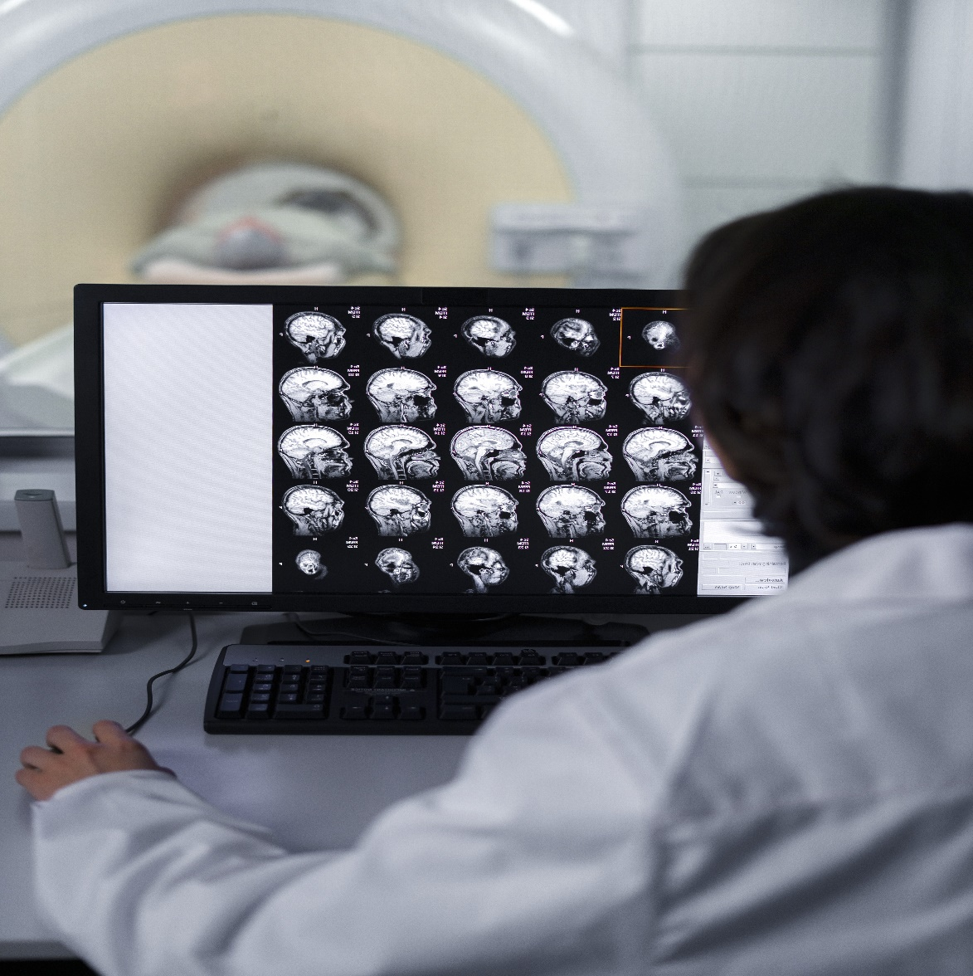



CT Image Denoising
PID_1544
Photo
(Author 1)
Photo
(Author 2)
Photo
(Author 3)
Jeet Nakrani
Mayank Kathane
Shubham Vishwakarma
College Name - Mukesh Patel School of Technology Management and Engineering
Location - Mumbai
College Mentor Name – Manishkumar Tiwari
Notes:
Title Text Font Calibri Body Bold, Font Size 34, Name and Designation Font Size 18

Slide 2
CT Image Denoising
PID_1544
Photo
(Author 1)
Photo
(Author 2)
Photo
(Author 3)
Jeet Nakrani
Mayank Kathane
Shubham Vishwakarma
College Name - Mukesh Patel School of Technology, Management and Engineering (NMIMS)
Location - Mumbai
College Mentor Name – Manishkumar Tiwari

Slide 3
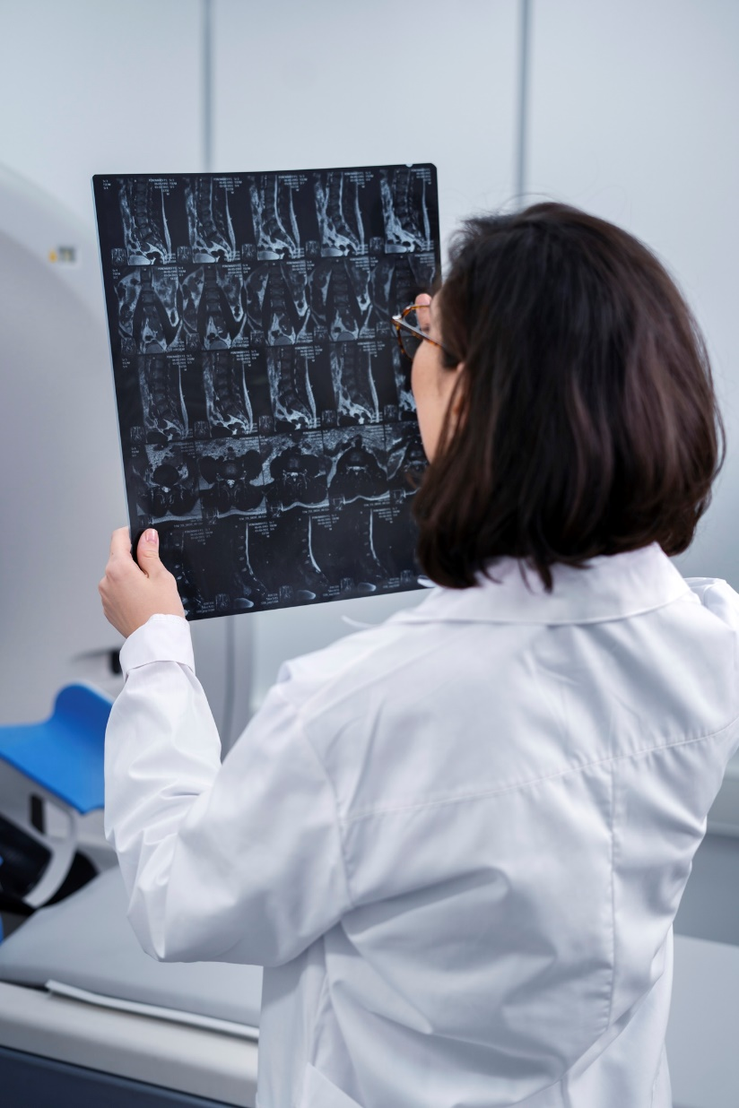

Index
Challenge Statement
Concept of the Solution
Novelty / Scope of Solution
Pros and Cons of the solution
Technical Description
Implementation Plan
Validation/Testing/Analysis
Cost Estimate
Assumptions
References

Slide 4
Challenge Statement
Understanding the Problem
In medical imaging, particularly brain CT scans, image quality is often compromised by two prevalent types of noise:
Poisson Noise:
Originates from the statistical nature of photon detection during image acquisition.
Periodic Noise:
Caused by interference from electronic and mechanical components in the CT scanner.
Challenge Requirement
The objective is to develop a software tool capable of:
Reading and displaying CT brain scans in DICOM format.
Designing an algorithm that reduces Poisson and periodic noise effectively.
Enhancing image clarity while preserving essential diagnostic information, leading to more accurate diagnoses.
1544

Slide 5
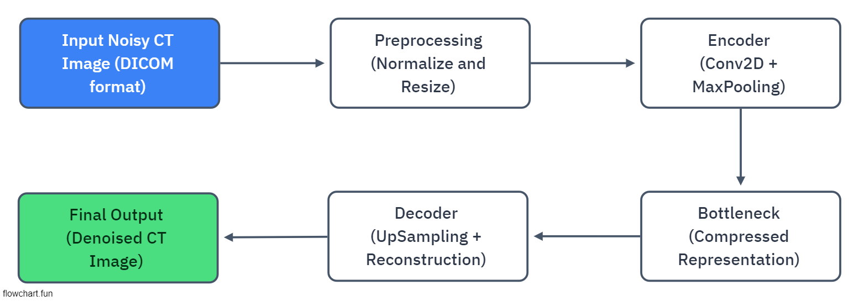
Concept of the solution
The proposed solution uses deep learning-based Denoising Autoencoders to remove noise from CT brain images.
The tool will take in noisy CT images as input and produce clean, denoised output for better clarity.
It involves a deep convolutional architecture, including an encoder-decoder structure, optimized with mean squared error loss.
1544

Slide 6
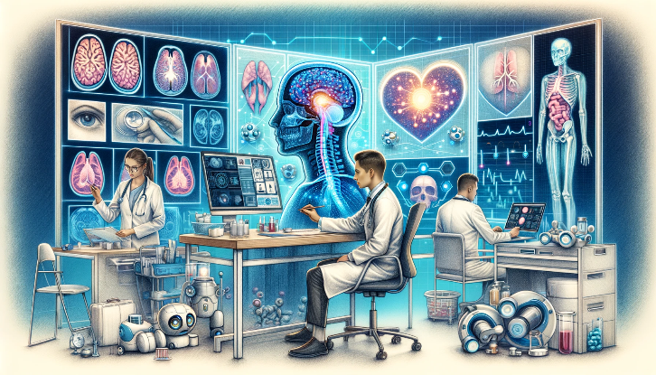
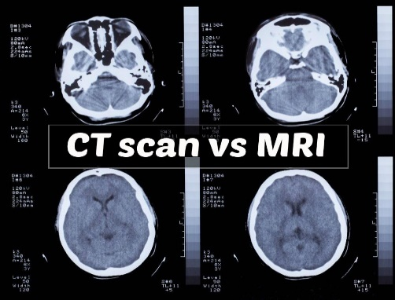
Novelty / Scope of Solution
Autoencoder Architecture: The use of a denoising autoencoder that learns both spatial and feature representations of CT images is an innovative approach, enabling automatic noise removal while preserving critical image details for diagnosis.
DICOM Integration: Handles CT scans in their native DICOM format, maintaining medical data integrity.
Medical Diagnostics: Enhances clarity in CT scans for better detection of pathologies such as tumors, hemorrhages, or structural anomalies in the brain.
Adaptability & Scalability: Potential to extend the solution to other imaging modalities (e.g., MRI) or apply it to real-time CT imaging workflows.
1544

Slide 7
Pros and Cons of the solution
Pros | Cons
Improved Image Quality: Removes Poisson and periodic noise without losing crucial image details. | Data Dependency: Performance depends on the quality and quantity of training data.
Fast and Efficient: GPU-accelerated deep learning models for real-time denoising | Computational Cost: Requires high computational power for training, especially with large datasets.
Scalable and Extensible: Can be applied to other imaging modalities or types of noise. | Risk of overfitting: Requires careful regularization and validation.
Easy Integration: Can be integrated into existing healthcare systems with minimal changes.
1544

Slide 8
Technical Description
A Convolutional Autoencoder with an encoder-decoder structure:
Encoder: Compresses noisy images using Conv2D and MaxPooling layers.
Decoder: Reconstructs the denoised image using UpSampling and Conv2D layers.
Activation Functions: ReLU for encoding, sigmoid for the output layer.
Model Training:
Uses mean squared error loss for pixel-wise image reconstruction.
Early stopping and learning rate scheduling to prevent overfitting and ensure efficient training.
Image Denoising:
After training, the model predicts clean images from noisy input.
SNR (Signal-to-Noise Ratio) is calculated to evaluate the quality of denoising by comparing the noisy and denoised images.
1544

Slide 9
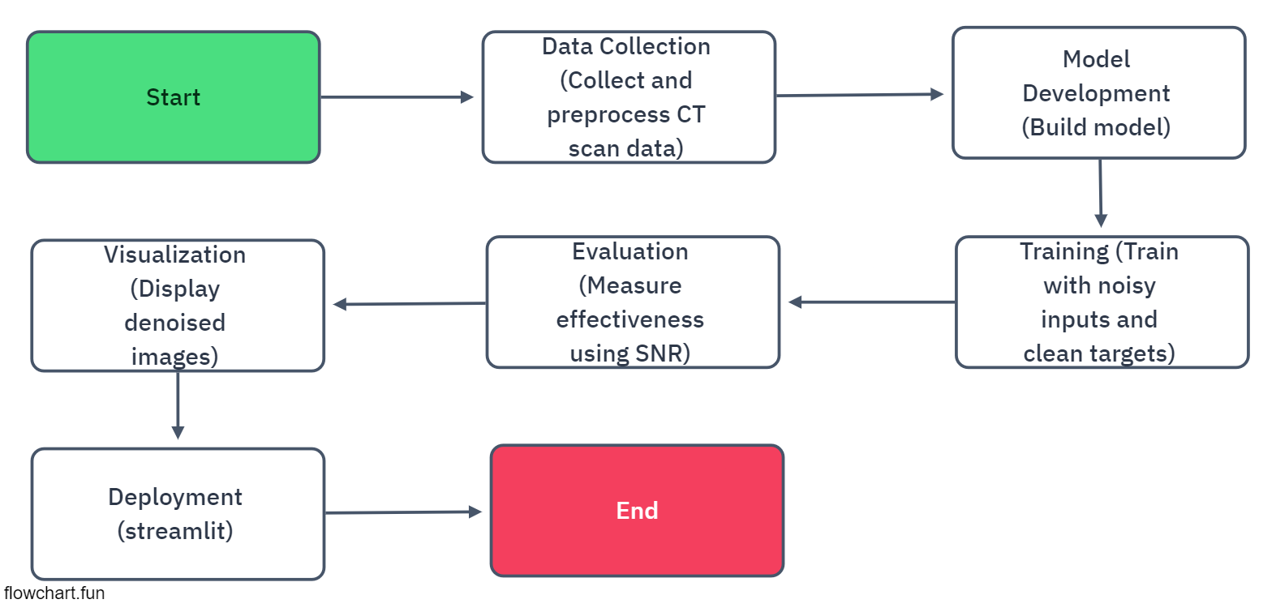
Implementation Plan
1544

Slide 10
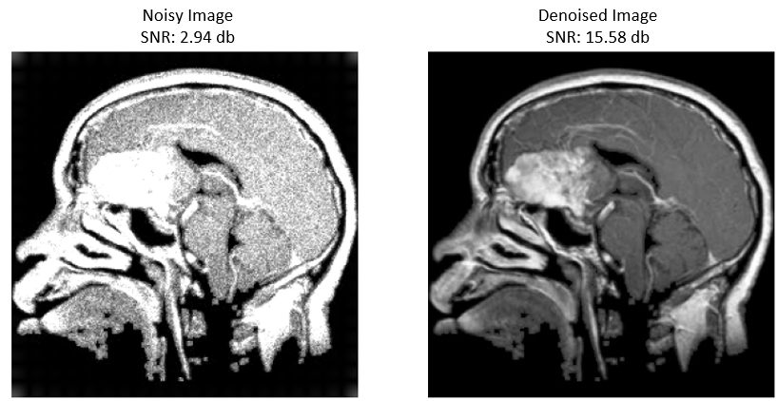
Validation / Testing / Analysis
Testing Metrics:
SNR: Measure the improvement in signal quality after denoising.
Visual Comparison: Display side-by-side images of noisy and denoised images.
Quantitative Evaluation: Compare model performance on multiple test images and assess noise reduction capabilities.
Analysis:
Evaluate the impact of denoising on diagnostic accuracy by conducting tests with medical professionals (optional, if data available).
1544

Slide 11
Cost Estimate
Cost Category | Approximate Cost (INR) | Description
Data Collection | ₹41,500 - ₹83,000 | Costs for obtaining and preprocessing CT scan datasets.
Computational Resources | ₹1,24,500 - ₹2,49,500 | Cloud GPU usage, servers, and storage for training and validation.
Testing & Validation | ₹41,500 - ₹83,000 | Costs associated with evaluating model performance (SNR calculation, validation).
Deployment & Maintenance | ₹83,000 - ₹2,08,500 | Deployment on servers, maintenance, and updates.
Personnel | ₹4,15,000 - ₹8,30,000 | Salaries for data scientists, engineers, and developers involved in the project.
Note: -
The above cost estimate is approximate and may vary based on project scope, resource availability, and specific requirements.
Total Estimated Cost: ₹5,05,500 - ₹13,53,000
1544

Slide 12
Assumptions
Sufficient high-quality CT scan data is available for training.
Adequate computational resources (cloud-based GPUs) for model training and evaluation.
The denoising solution will be primarily focused on brain CT scans, and its performance may vary with other body parts or imaging techniques.
Compliance with relevant healthcare data privacy regulations (e.g., HIPAA, GDPR).
1544

Slide 13
References
List of research papers or articles on CT image denoising, Autoencoders, and related deep learning techniques.
Larrue, Tara, etal.”Denoising Videos with Convolutional Autoencoders.”(2018).
Xie, Junyuan,LinliXu, and EnhongChen. ”Image denoising and in painting with deep neural networks.”Advances in neural information processing systems. 2012.
Dabov, Kostad in , etal. ”BM 3D image denoising with shape-adaptive principal component analysis.”SPARS’09-Signal Processing with Adaptive Sparse Structured Representations.2009.
Image Denoising based on Deep Learning – Zeyu Li https://drive.google.com/file/d/1sJKonZFW6PhQg4-AKRriazfPnhD1v_m3/view
Brief review of image denoising techniques - Linwei Fan1,2,3, Fan Zhang2,Hui Fan2 and Caiming Zhang1,2,3 - https://drive.google.com/file/d/1TA43lQucTmFZyyxK1AGY5-3-pwXDB7yq/view
Reference to any medical imaging databases used (e.g., Kaggle).
TensorFlow/Keras Documentation for model implementation.
Dataset - https://www.kaggle.com/datasets/sartajbhuvaji/brain-tumor-classification-mri
Image References: - https://artificialpaintings.com/blog/2024/06/14/ai-in-medical-diagnostics-empowering-healthcare-with-precision-and-efficiency/ , https://kingsmedical.com/blog/understand-the-differences-between-ct-and-mri/
1544

Slide 14


THANK YOU

